Slide 1

Ecologies of practice through distributed leadership in Visual Arts education
Dr Karen Maras
Australian Catholic University

Slide 2
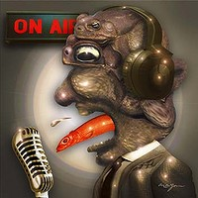
Cane toads of the air thrive on stupidity
  The most destructive effect of the shock-jockariat is the poisoning of the logic-well itself.
  Elizabeth Farrelly
Retrieved 13June2011 from http://www.smh.com.au/opinion/society-and-culture/cane-toads-of-the-air-thrive-on-stupidity-20110608-1fsuj.html

Slide 3
Purpose & Scope
Developing an understanding of the practices of VADEA in the context of the development of the Australian Curriculum for the Arts
How curriculum development and research may to connect to developing leadership and professional development within communities of practice in art education

Slide 4
Ecological Theory of Practice
Ecology of practice – any kind of social project
Meta-practices – create conditions under which we live
Relational architectures – pre-figure, pre-form
  Sayings (cultural-discursive)
  Doings (material-economic)
  Relatings (social-political)
Participant observation
Kemmis, S., Wilkinson, J., Hardy, I., & Edwards-Groves, C. (2009). Leading & Learning: developing ecologies of educational practice, AARE.

Slide 5
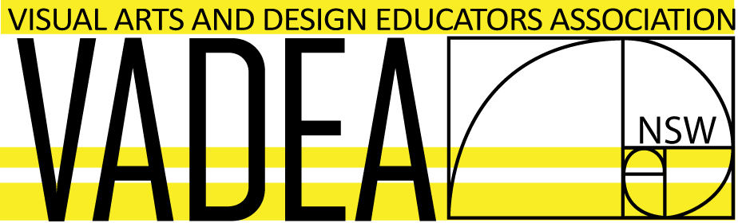

Meta-practices: art education history

Slide 6
Meta-practices: Global/Federal
Standards, Marketisation, managerialism
Literacy and numeracy imperatives
League tables
official curriculum/reduced choice & focus
MCEEDYA
Centralised education bureaucracies:
ACARA, AITSL

Slide 7
Meta-practices: ACARA
Meta-managerialism
Common content – The Arts
The Arts V Visual & Performing Arts
Subjects V Learning Areas
Climate change

Slide 8
ACARA/Art Education - national
Sayings, doings, relatings
Expertise and leadership
Representation of Visual Arts EDUCATION
reference groups, advisory panels, writers
State associations, teachers
Researchers
‘trouble-making’ (Freedman, 2007)

Slide 9
VADEA adapts & evolves practices
Art Education Australia – re-affiliation
National Association for Visual Arts - industry
Visual Arts Round Table
Visual Arts Consortium – the field of art
Relationships with other State associations
AEA Position Paper based on VADEA principles for good curriculum

Slide 10
VADEA & Research
Practice of research-based curriculum development
Antecedents in previous curriculum change
Forums for exchange
Some solidarity but common goals
Emancipatory practice

Slide 11
VADEA & Leadership/Professional development
‘changing practice is as an extra-individual process [and] requires changing not only the actions of individuals but also making changes in the social, discursive and historical dimensions in which practices are constituted and reconstituted, as they evolve over time’ (Kemmis, 2005)
The web of sayings, doings and relatings within the professional ecosystem of art education reveals that leadership is increasingly distributed and dependent on research as a means for evolution.

Slide 12
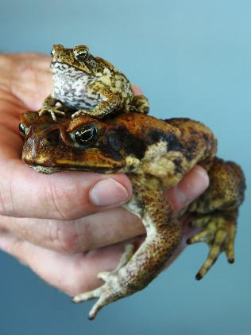
Relatings: science, residents, pests
The best way to euthenase cane toads is to freeze them. Cane toad expert Professor Rick Shine: “they will certainly die during winter as Sydney is at the edge of their suitable habitat and they may only be able to survive in some environments but in all likely-hood, not all”.

